Slide 1
ETL
Musadaq Mansoor

Slide 2
Introduction
In computing, extract, transform and load (ETL) refers to a process in database usage and especially in data warehousing that involves:
Extracting data from outside sources
Transforming it to fit operational needs (which can include quality levels)
Loading it into the end target (database, more specifically, operational data store, data mart or data warehouse)

Slide 3
Extract
The first part of an ETL process involves extracting the data from the source systems. In many cases this is the most challenging aspect of ETL, as extracting data correctly will set the stage for how subsequent processes will go.
Most data warehousing projects consolidate data from different source systems. Each separate system may also use a different data organization/format. Common data source formats are relational databases and flat files, but may include non-relational database structures

Slide 4
Extract
An intrinsic part of the extraction involves the parsing of extracted data, resulting in a check if the data meets an expected pattern or structure. If not, the data may be rejected entirely or in part.

Slide 5
Transform
The transform stage applies to a series of rules or functions to the extracted data from the source to derive the data for loading into the end target.
Some data sources will require very little or even no manipulation of data. In other cases, one or more of the following transformation types may be required to meet the business and technical needs of the target database:

Slide 6
Transform
Selecting only certain columns to load (or selecting null columns not to load). For example, if the source data has three columns (also called attributes), for example roll_no, age, and salary, then the extraction may take only roll_no and salary. Similarly, the extraction mechanism may ignore all those records where salary is not present (salary = null).
Transposing
Splitting

Slide 7
Transform
Translating coded values (e.g., if the source system stores 1 for male and 2 for female, but the warehouse stores M for male and F for female)
Encoding free-form values (e.g., mapping "Male" to "1")
Deriving a new calculated value (e.g., sale_amount = qty * unit_price) Sorting
Joining data from multiple sources (e.g., lookup, merge) and deduplicating the data
Aggregation

Slide 8
Load
The load phase loads the data into the end target, usually the data warehouse (DW). Depending on the requirements of the organization, this process varies widely.
Some data warehouses may overwrite existing information with cumulative information, frequently updating extract data is done on daily, weekly or monthly basis. Other DW (or even other parts of the same DW) may add new data in a historicized form, for example, hourly.
To understand this, consider a DW that is required to maintain sales records of the last year. Then, the DW will overwrite any data that is older than a year with newer data. However, the entry of data for any one year window will be made in a historicized manner.

Slide 9
Load
The timing and scope to replace or append are strategic design choices dependent on the time available and the business needs. More complex systems can maintain a history and audit trail of all changes to the data loaded in the DW.

Slide 10
ETL Life Cycle
The typical real-life ETL cycle consists of the following execution steps:
1. Cycle initiation
2. Build reference data
3. Extract (from sources)
4. Validate
5. Transform (clean, apply business rules, check for data integrity, create aggregates or disaggregates)
6. Stage (load into staging tables, if used)
7. Audit reports (for example, on compliance with business rules. Also, in case of failure, helps to diagnose/repair)
8. Publish (to target tables)
9. Archive
10. Clean up

Slide 11
Challenges
ETL processes can involve considerable complexity, and significant operational problems can occur with improperly designed ETL systems.
The range of data values or data quality in an operational system may exceed the expectations of designers at the time validation and transformation rules are specified.
Data profiling.

Slide 12
PETL
https://petl.readthedocs.io/en/v0.16/

Slide 13
Extract Examples

Slide 14
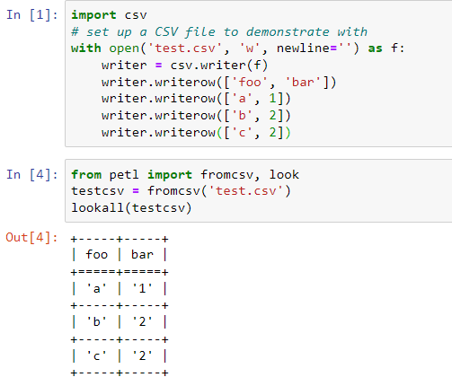
CSV

Slide 15
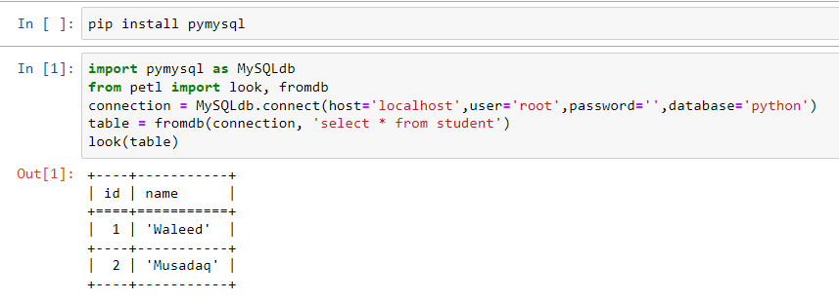
MySql

Slide 16
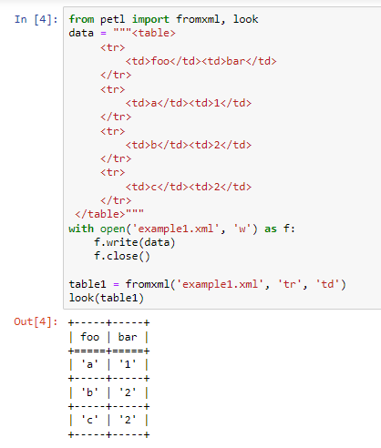
xml

Slide 17
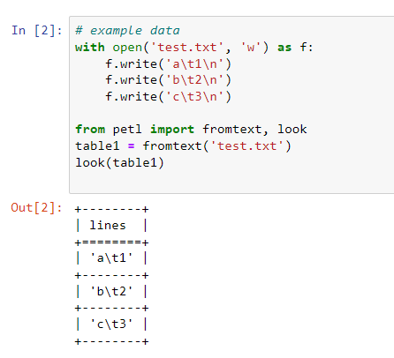
txt

Slide 18
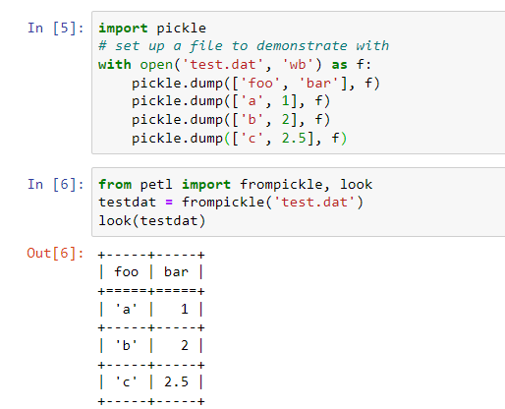
dat

Slide 19
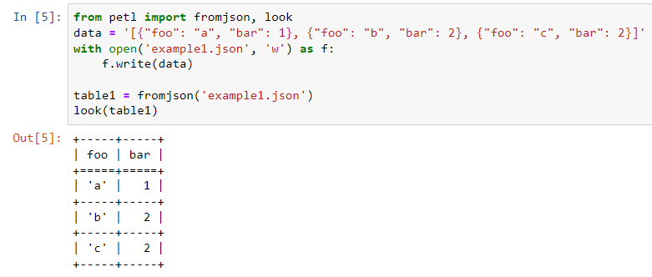
json

Slide 20
Transform

Slide 21
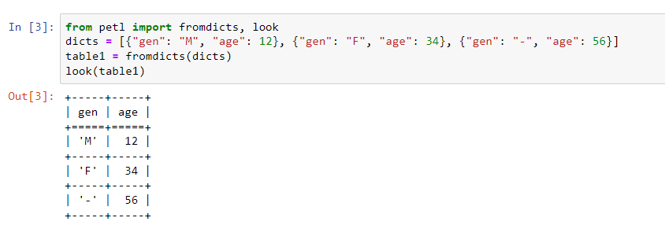
Rename

Slide 22
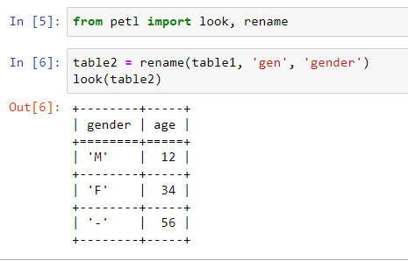
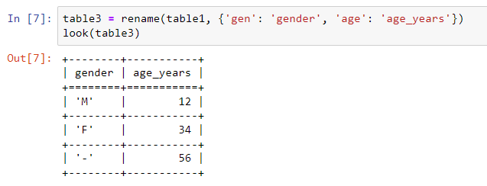
Rename

Slide 23
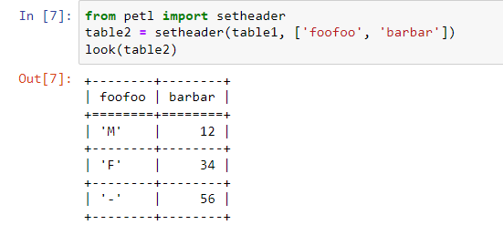
setheader

Slide 24
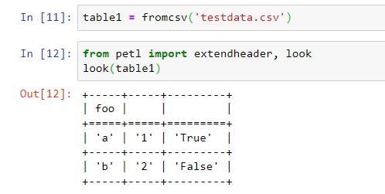
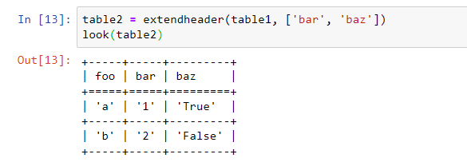
extendheader

Slide 25
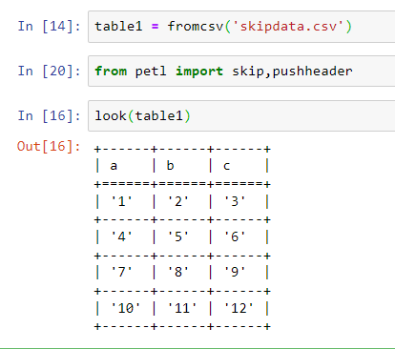
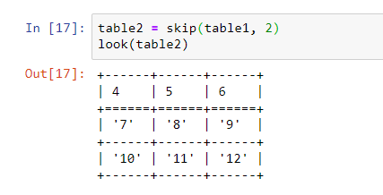
skipdata

Slide 26
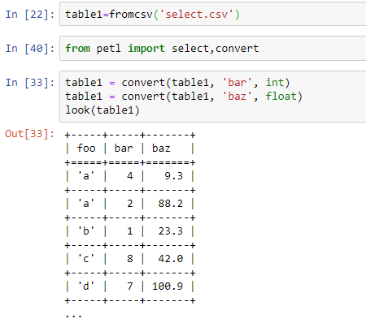
convert

Slide 27
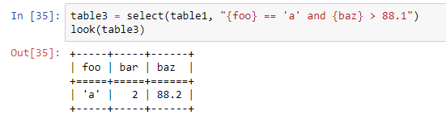
select

Slide 28
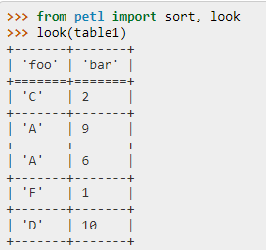
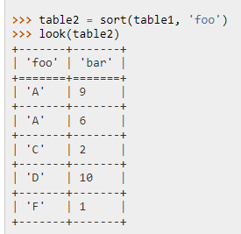
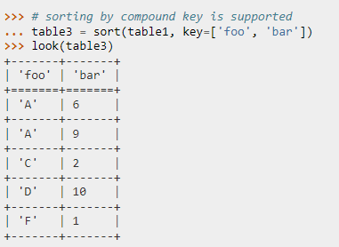
sort

Slide 29
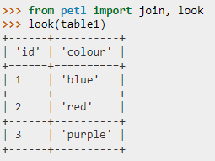
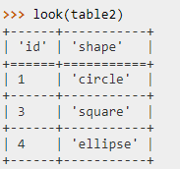
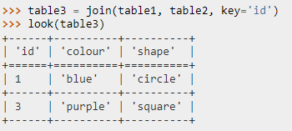
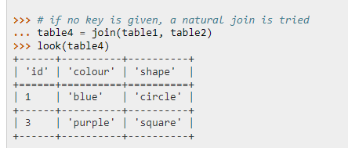
join

Slide 30
Load

Slide 31
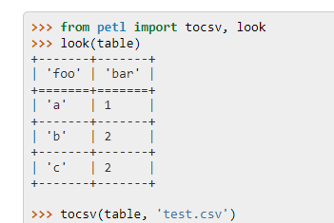
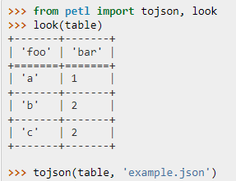
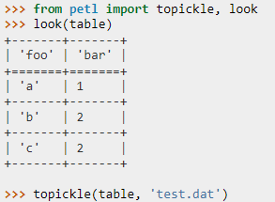
Some load functions

